Slide 1
LS-1101-2023
Lipids and Membranes

Slide 2
Introduction
Lipids are hydrophobic, nonpolar molelcules.
  They are soluble in nonpolar solvent.
  They are insoluble in polar solvents, such as water
They are isolated from the other biological molecules by extracting them with nonpolar solvents.

Slide 3
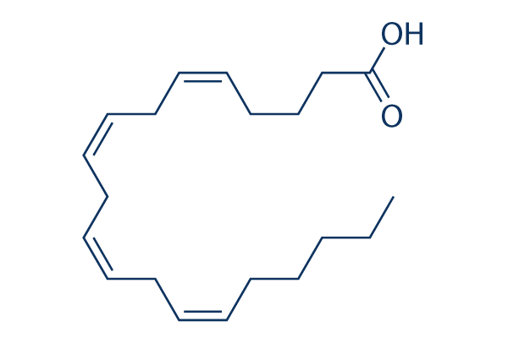
Introduction
The types of lipids
  Fatty Acids
    In the carboxylic acid family
  Waxes
    Fatty Acids + Alcohols
  Triglycerides
    3 Fatty acids + glycerol
  Phospholipids and glycolipids
    2 fatty acids + glycerol + phosphate + X
  Steroids
    Derivatives of cholesterol
  Eicosanoids
    Derivatives of the Fatty acid arachidonic acid
    Membranes
    Formed from phospholipids and glycolipids

Slide 4
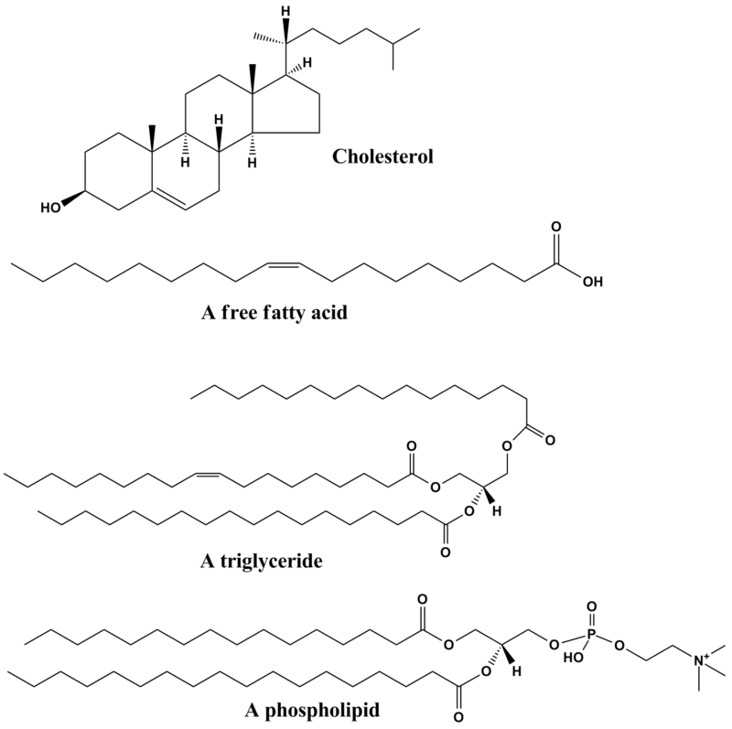
Lipids
Functions
Energy storage
Membrane structure
Membrane transport
Cell Signaling
Any other function?
Fats give more energy when broken down
Fats can be store in less space than glucose
Fats need less water to be stored

Slide 5
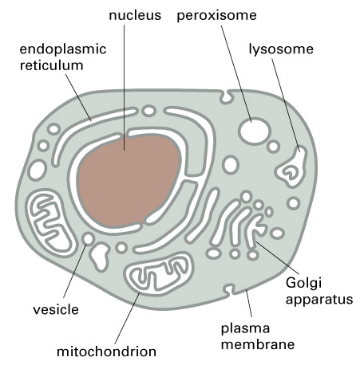
Membranes form many compartments in the cell

Slide 6
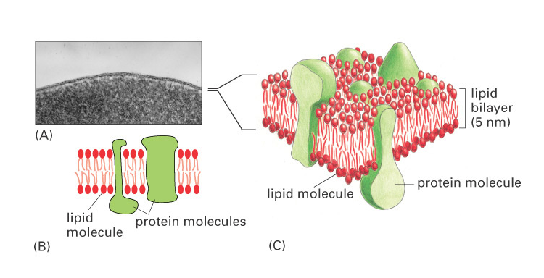
Biological membranes are composed of a lipid bilayer

Slide 7
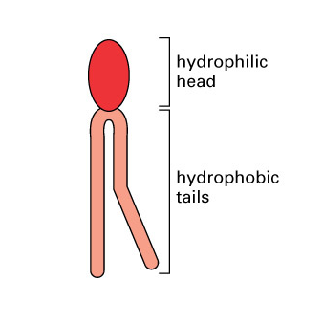
Membrane lipids are amphipathic molecules
Membrane lipids are amphipathic
Hydrophilic heads (polar) form hydrogen bonds with water
Hydrophobic tails (non-polar) are excluded by water molecules

Slide 8
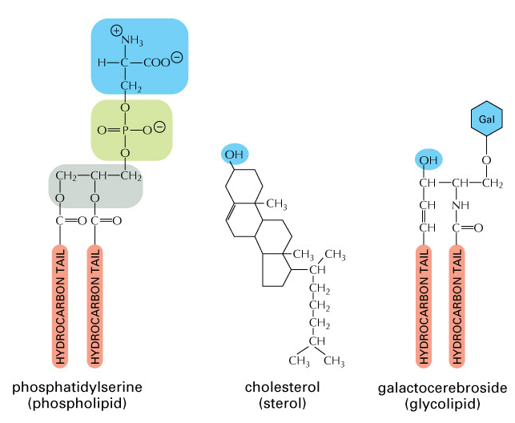
Three classes of membrane lipids

Slide 9
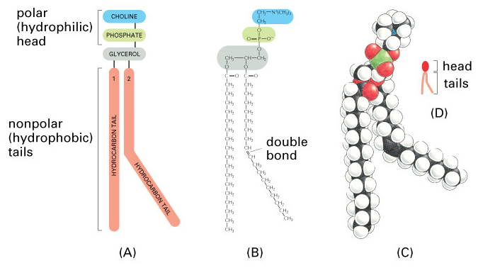
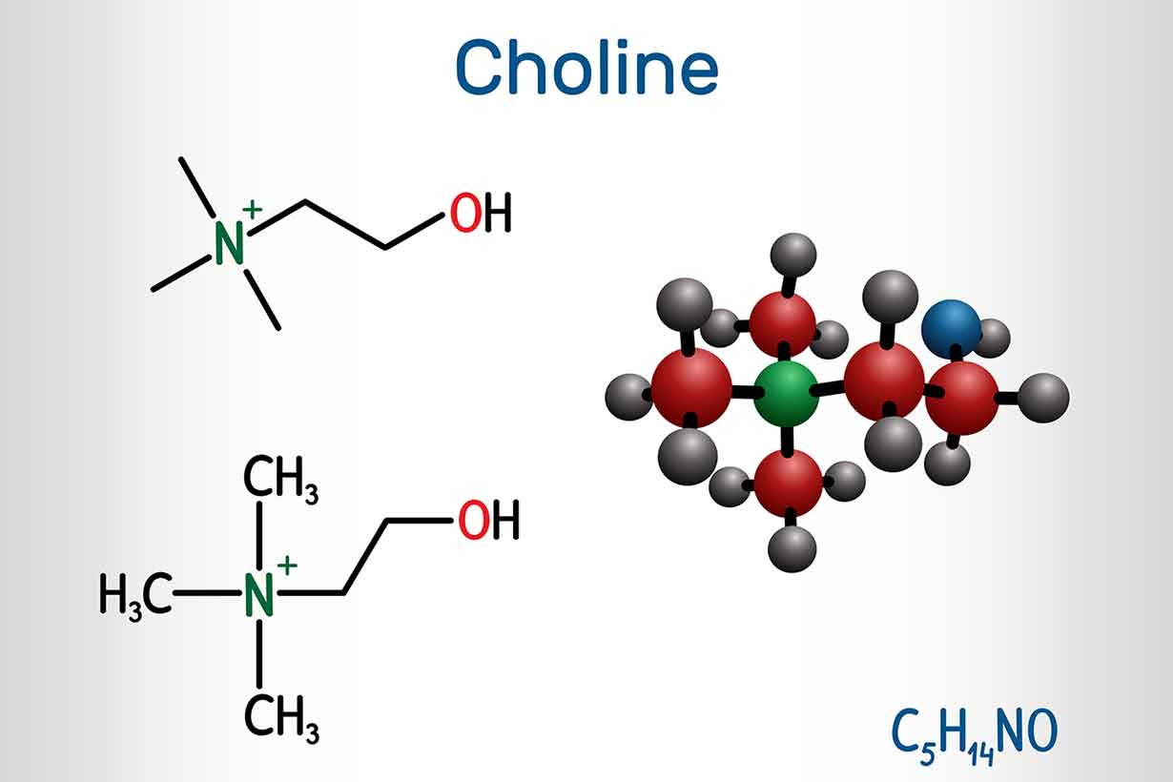
Membrane lipids
Phosphatidylcholine is the most abundant phospholipid in cell membranes

Slide 10
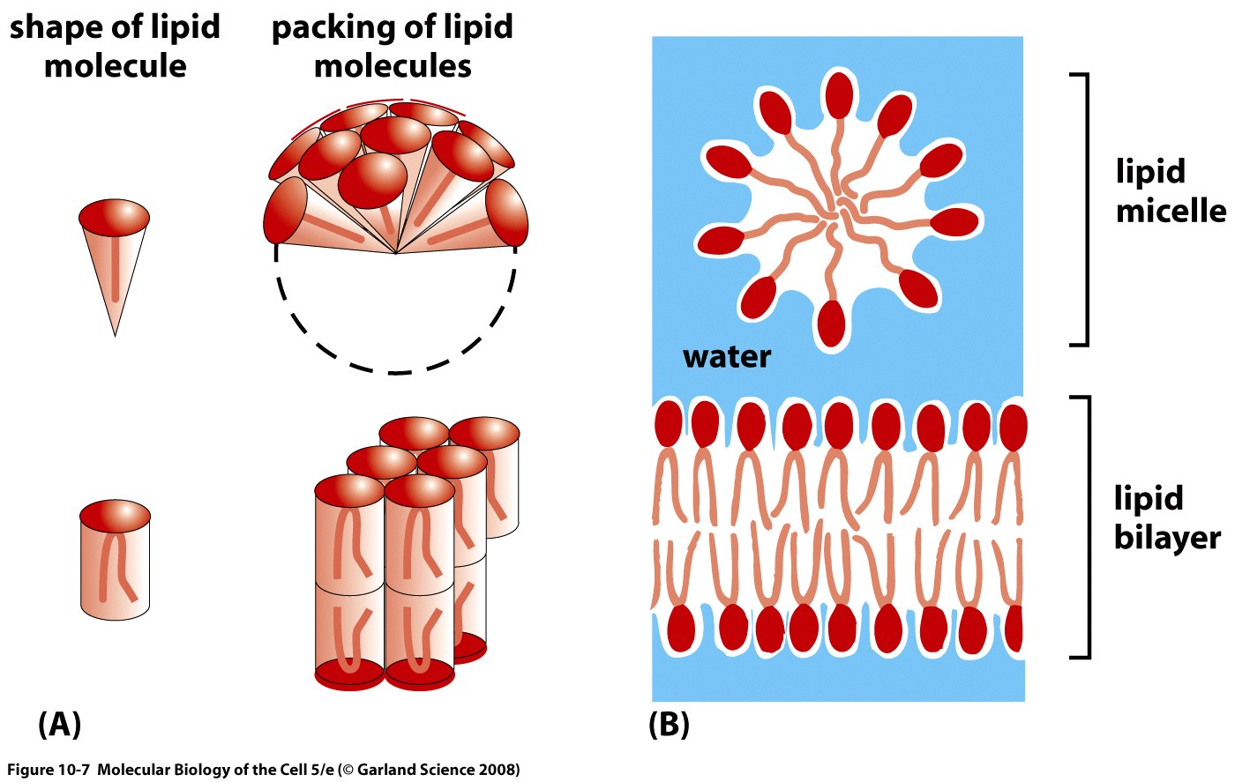
Packing arrangements of lipid molecules in an aqueous environment
Cone-shaped lipid molecules for micelles, cylinder-shaped lipids form bilayers

Slide 11
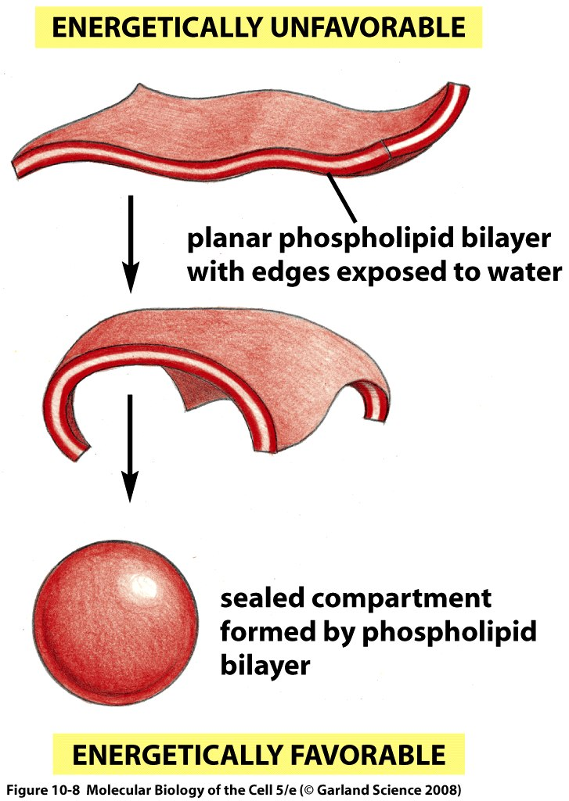
Phospholipid bilayers spontaneously close to form a sealed compartment

Slide 12
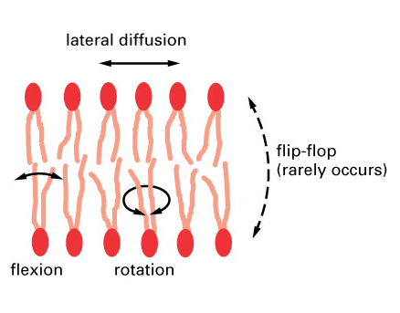
The membrane bilayer is a fluid
Lateral diffusion occurs rapidly within the plane of the membrane
Individual phospholipids may rotate axially
Flip-flopping from one side to the other is very rare as it is energetically
unfavorable

Slide 13
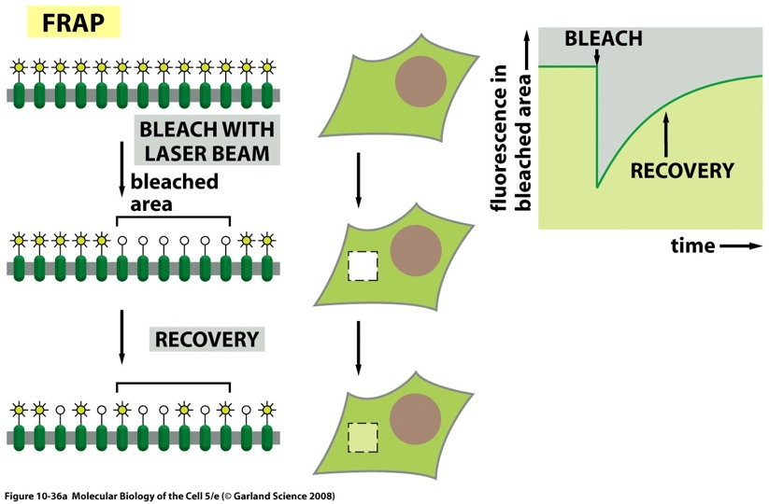
The membrane bilayer is a fluid
Fluorescence Recovery After Photo-bleaching (FRAP)
A fluorescent probe is used to label membrane proteins
The probe is destroyed in a small region using intense laser light
Fluorescence microscopy is used to observe behavior of the unbleached probe

Slide 14
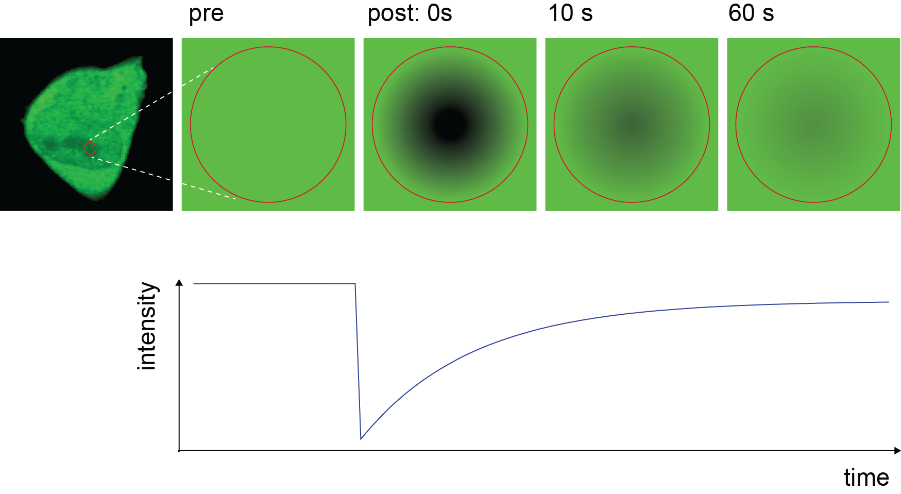
Who controls the membrane fluidity?

Slide 15
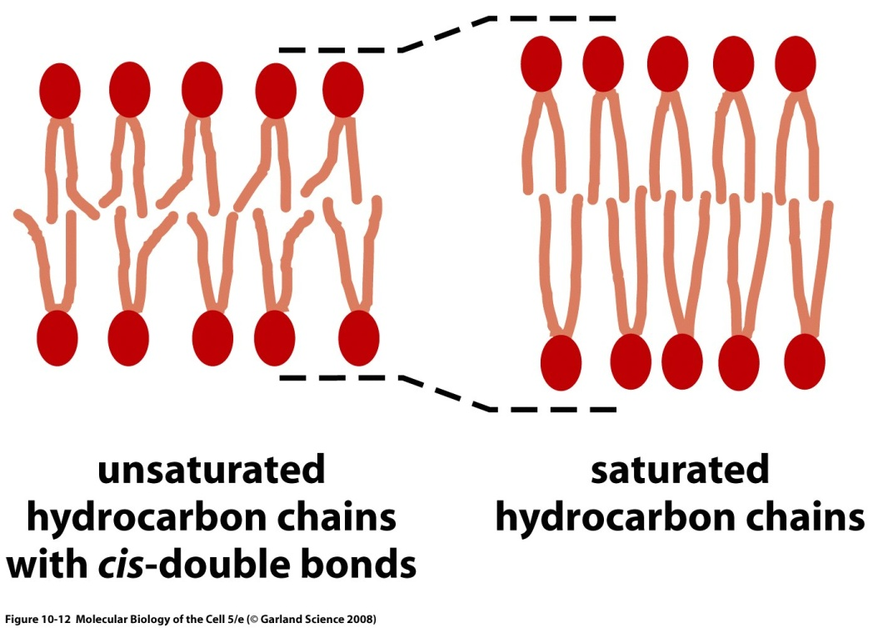
The composition of a membrane regulates the degree of its fluidity
Membrane lipids with fatty acyl side chains that are saturated (no double bonds) pack tightly in the membrane and make it less fluid
Lipids that are unsaturated (1, 2, or 3 double bonds) pack loosely and make it more fluid

Slide 16
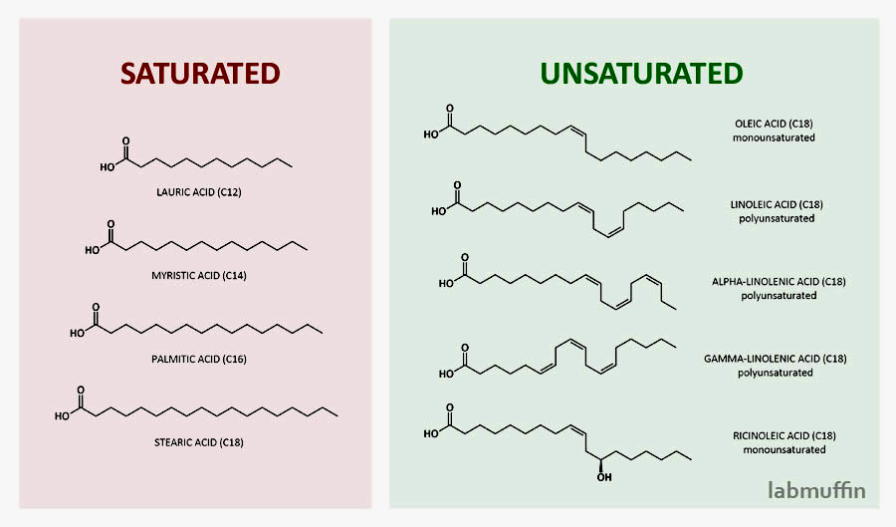
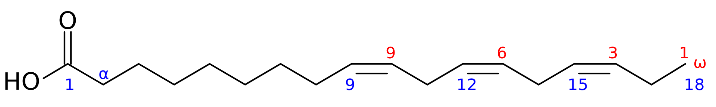

Slide 17
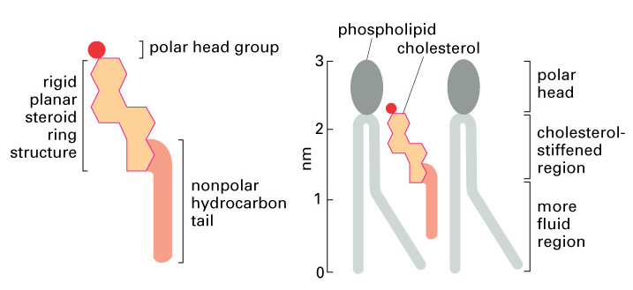
The composition of a membrane regulates the degree of its fluidity
The presence of cholesterol in the membrane stiffens the bilayer making it more rigid

Slide 18
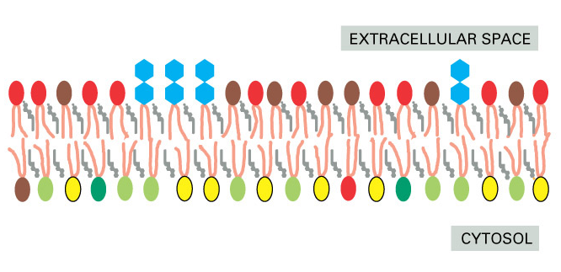
Cellular membranes are asymmetric
All lipids are synthesized on the cytosolic surface of the ER
Lipids in the outer leaflets are transported there by flippases
Continuity between organelle lumen & extracellular space

Slide 19
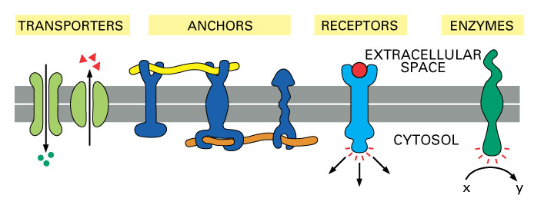
Membrane proteins
Proteins compose ~50% of the membrane
Membrane proteins perform many functions

Slide 20
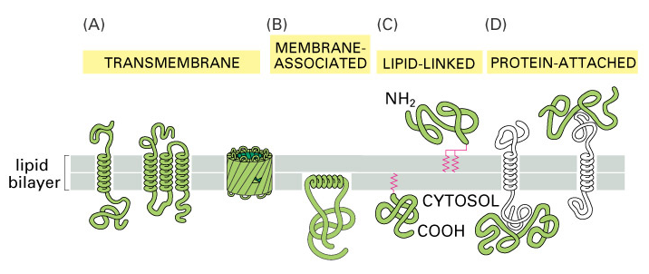
Membrane proteins associate with the bilayer in different ways
Transmembrane proteins span the bilayer
Peripheral membrane proteins associate with one side

Slide 21
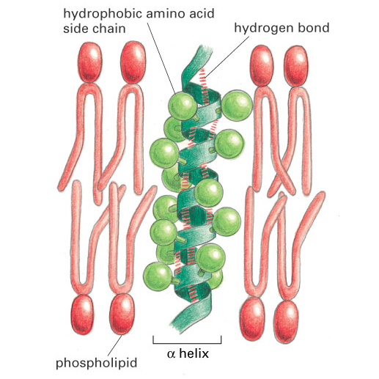
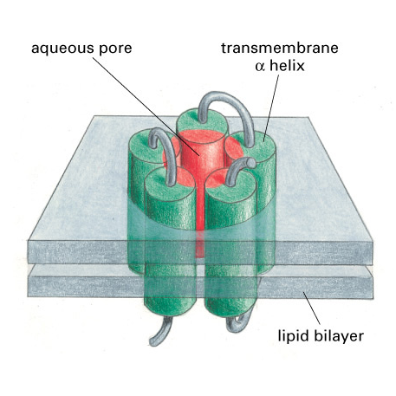
Transmembrane proteins usually span the bilayer using alpha-helices

Slide 22
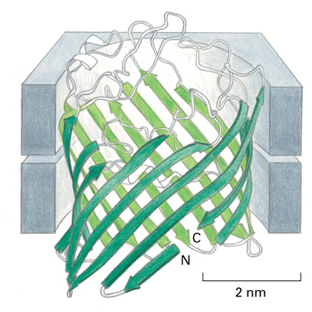
Some membrane proteins use beta-sheets to cross the bilayer
Beta-sheets arranged in this cylindrical conformation are known as a “beta-barell”
Hydrophilic amino acid residues face towards the pore, hydrophobics face the bilayer

Slide 23
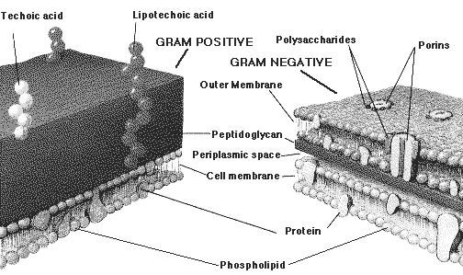
Bacterial cell surface

Slide 24
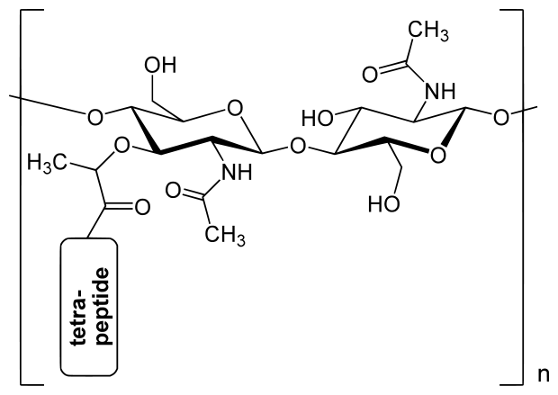
Peptidoglycan

Slide 25
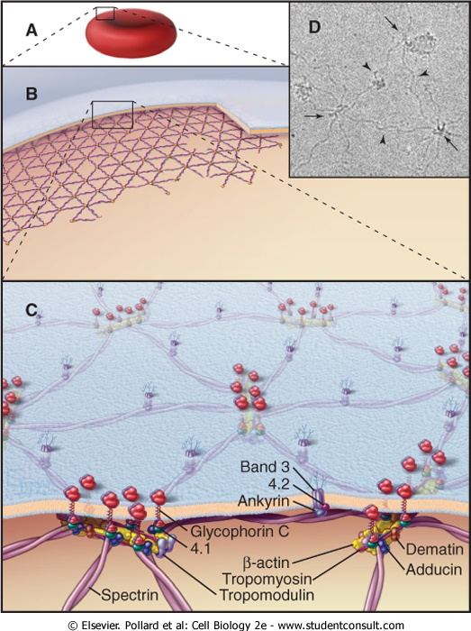
The cytoplasmic side of the membrane is called the cell cortex
Meshwork of transmembrane proteins and filaments (spectrin)
Mechanical support for the membrane and cell shape

Slide 26
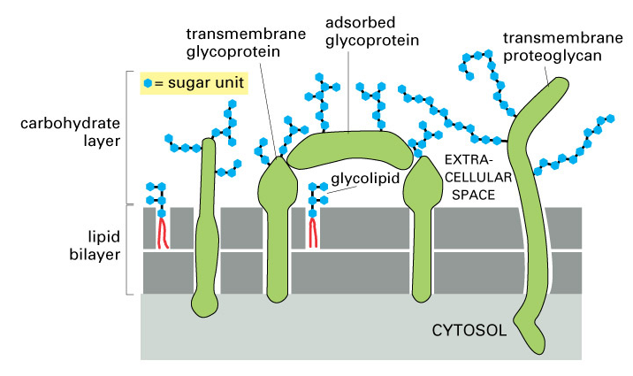
The extracellular surface of the membrane is coated with carbohydrate

Slide 27
Extracellular glycoproteins perform numerous functions
Carbohydrate layer protects cells from chemical and mechanical damage
Different cell types present different combinations of glycoproteins and proteoglycan on their surface - molecular signature
Information in the carbohydrate layer aids in cell-cell recognition and communication

Slide 28
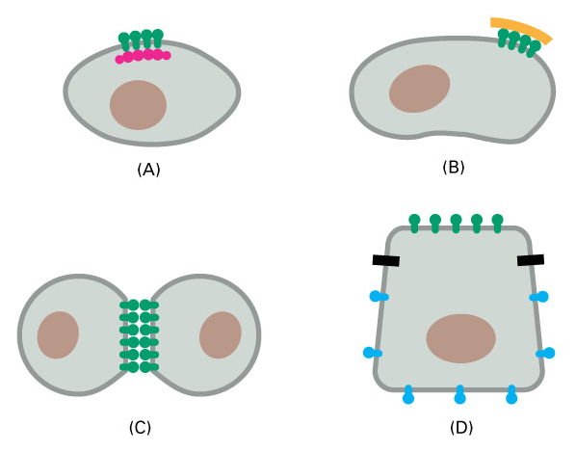
Cells use different mechanisms to restrict membrane protein movements
By tethering to elements inside of the cell (cortex)
By tethering to elements outside of the cell
By interacting with proteins on the surface of another cell
By diffusion barriers established within polarized cells

Slide 29
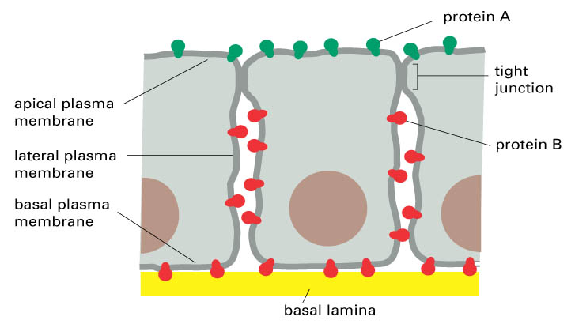
Epithelial cell polarity

